Slide 1
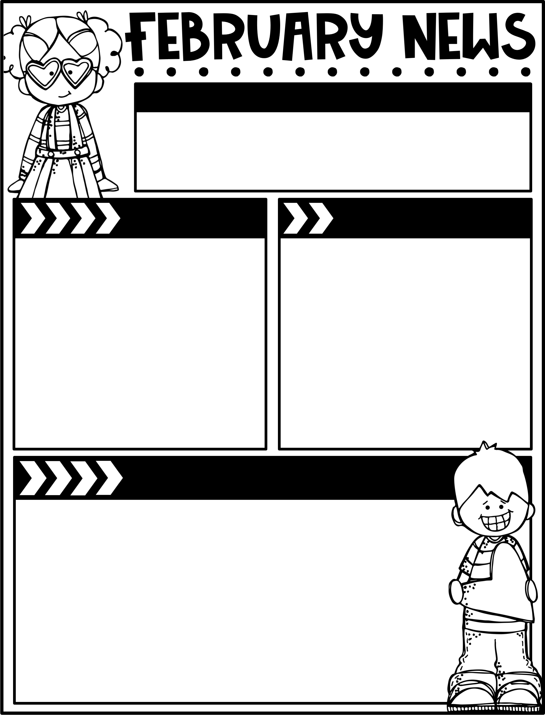
February 14, 2025
The Moreau Heights family is committed to providing a positive and safe learning environment to support responsible and productive citizens.
Phone:
573-659-3180
Plan Time:
1:35-2:25 pm
Emails:
mason.johnson@jcschools.us
danielle.mcgeorge@jcschools.us
theresa.schell@jcschools.us
Calendar
Learning Targets
M 2/17 No School- Presidents’ Day
TU 2/18 B Day
W 2/19 C Day
Th 2/20 D Day
F 2/21 A Day, Library Checkout
TH 2/27 Steam Night 5:30
Reading/Writing
I can use apostrophes to form contractions & to show possession.
I can read & identify the subjects & predicates of sentences.
I can capitalize the first letters of holidays & geographic names.
Math
I can use compensation to add within 1000.
I can use concrete models to add & relate them to written recordings.
I can fluently add within 20.
Social Studies
I can discuss the difference between a need and a want.
Things to Know
Specials Schedule:
Library Check-Out:
Second grade has check-out on Fridays! Please help your child remember their books!
SECOND STEP LESSON 18:
Problem Solving
Summary
In this week’s lesson, your child
will have opportunities to evaluate
different solutions to a problem.
Try This at Home
Ask your child for examples of which
solutions are better than others for
a problem.
 | Mr. J | Mrs. M | Ms. S
A | Music | PE | Art
B | PE | Art | Music
C | Art | Music | PE

